Slide 1

DATA CHALLENGE 2020
Organization: Metropolitan Washington Council of Governments (MWCOG) Project Name: Regional Traffic Count
Team 43 : Marc Marcelin Shweta Malla Abhishek Mangla Neviya Prakash

Slide 2
Introduction
Introduction
Problem
Methods
Findings
Suggestions

Slide 3

The Problem
The Washington DC Metropolitan area has some of the worst traffic. With the MWCORG dataset we which to analyze and paint a story that illustrates what happens during these traffic conditions.

Slide 4




Methods
Step 4
Step 3
Step 2
Step 1
Visualization: Graph, map, and cross reference our findings
Hypothesis: Formulate questions and conduct hypothesis testing in dataset
Explore: Exploratory analyzation of our data and themes do we see
Research: Analyzed dataset and overall traffic themes

Slide 5
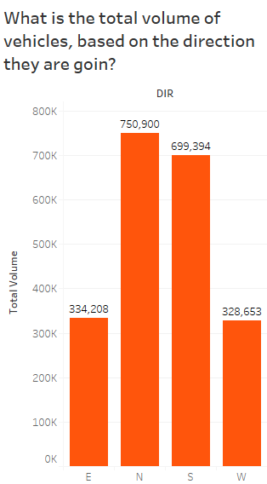
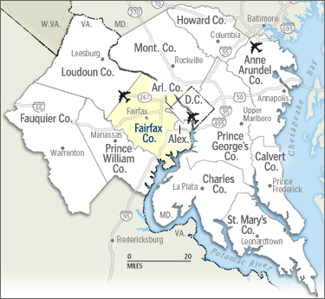

Slide 6
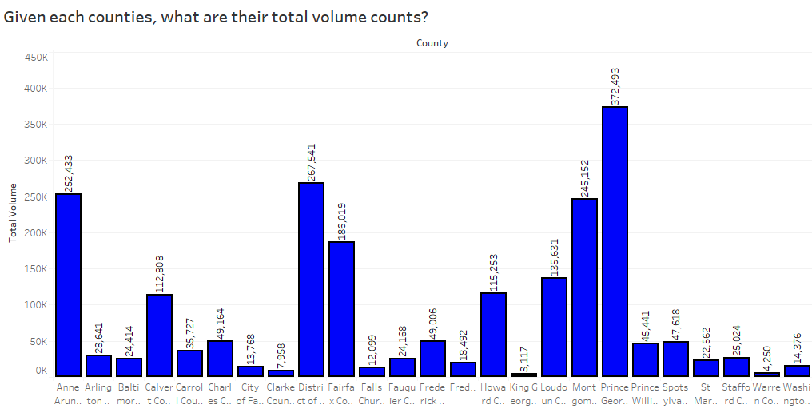

Slide 7
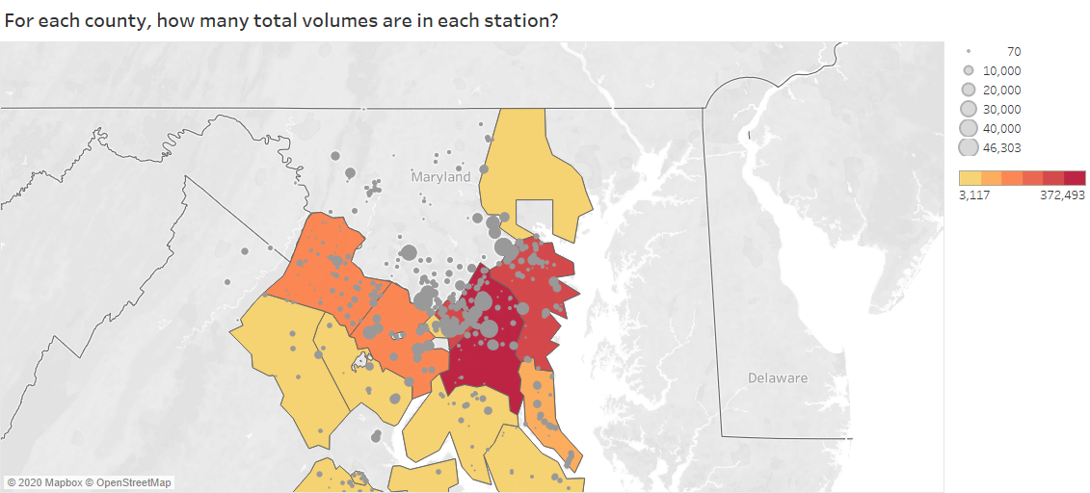

Slide 8
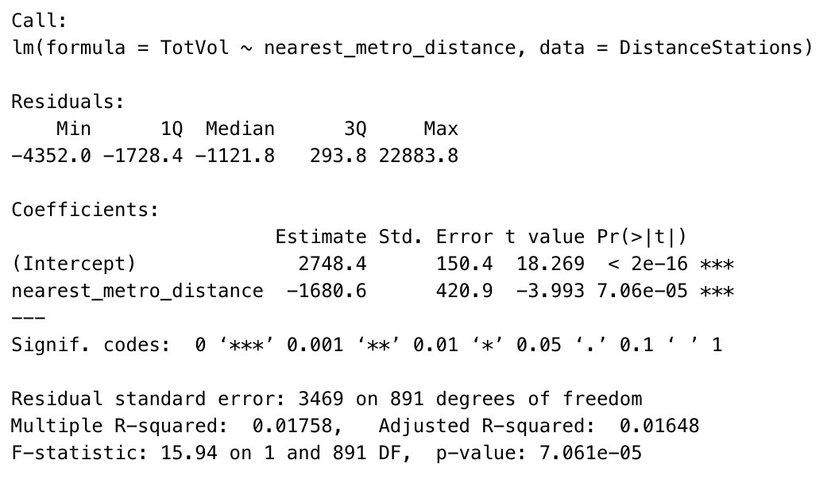
Finding a relationship between Total traffic and Distance from the nearest metro

Slide 9
Findings
Traffic around borders and intersections is the highest
High traffic around the region shows high economic activity

Slide 10

Our suggestions for a sustainable planet
Odd-Even rule
Provide affordable transport to public
Cycling and walking incentives

Slide 11

Future Scope
We plan to add the census data to test traffic conditions against Accessibility index, jobs accessibility by transit as well as income.

Slide 12
THANK YOU!

